Slide 1

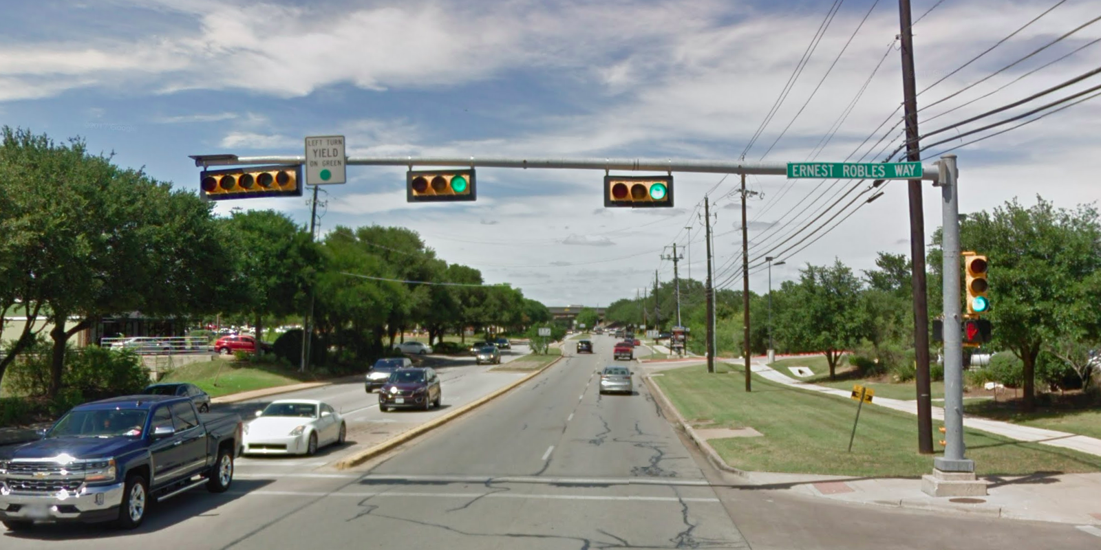
Austin Transportation Department Signs Work Orders
Created By: Susanne Gov Created Date: 2020-08-10 Location Name: BRODIE LN / ERNEST ROBLES WAY Intersection ID: 5148691 Cardinal Direction: N Work Order ID: SG-20423
Sign Type | Install/Remove
Left Turn Yield On Green | Install
Street Name Sign | Install

Slide 2
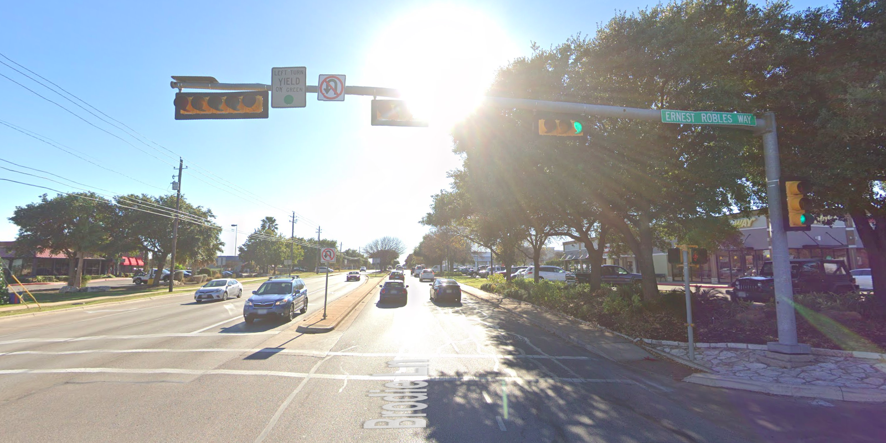
Austin Transportation Department Signs Work Orders
Created By: Susanne Gov Created Date: 2020-08-10 Location Name: BRODIE LN / ERNEST ROBLES WAY Intersection ID: 5148691 Cardinal Direction: S Work Order ID: SG-20423
Sign Type | Install/Remove
Left Turn Yield On Green | Install
Street Name Sign | Install
No U Turn Arrow | Install

Slide 3
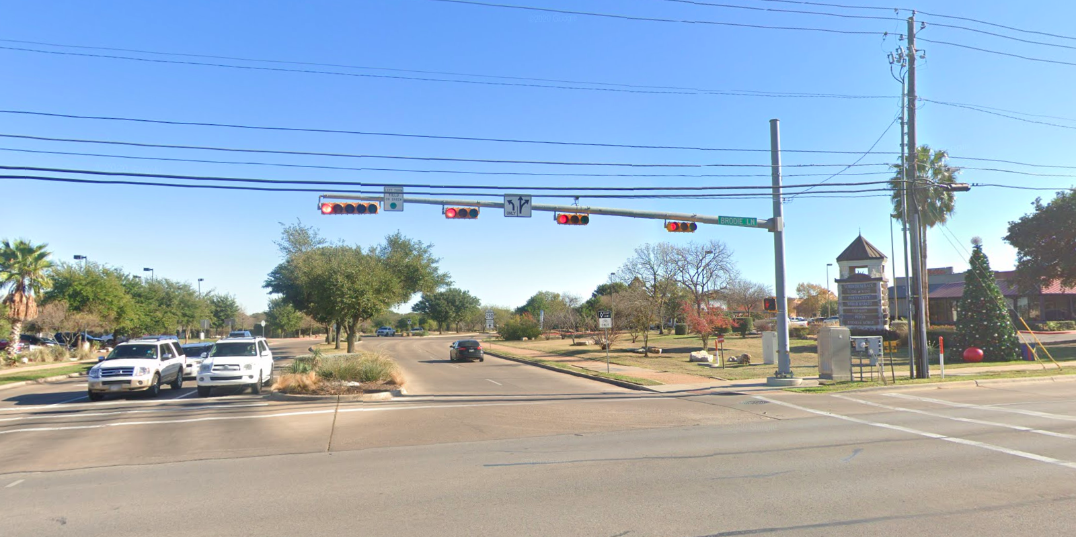
Austin Transportation Department Signs Work Orders
Created By: Susanne Gov Created Date: 2020-08-10 Location Name: BRODIE LN / ERNEST ROBLES WAY Intersection ID: 5148691 Cardinal Direction: E Work Order ID: SG-20423
Sign Type | Install/Remove
Left Turn Yield On Green | Install
Left Turn Arrow Only | Install
Street Name Sign | Install
Straight Right Arrow | Install

Slide 4
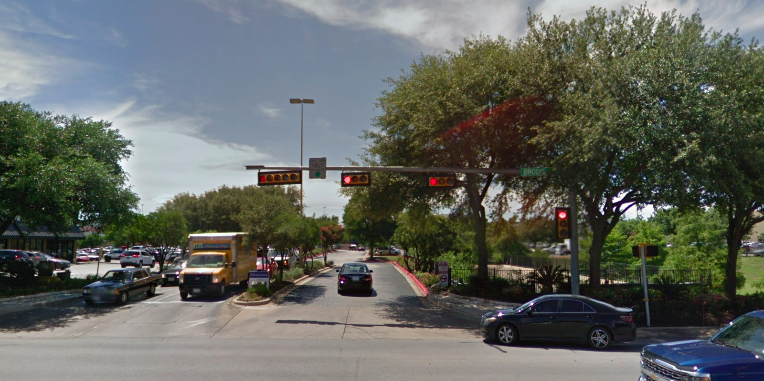
Austin Transportation Department Signs Work Orders
Created By: Susanne Gov Created Date: 2020-08-10 Location Name: BRODIE LN / ERNEST ROBLES WAY Intersection ID: 5148691 Cardinal Direction: W Work Order ID: SG-20423
Sign Type | Install/Remove
Left Turn Yield On Green | Install
Street Name Sign | Install

